Slide 1
Payroll Management
Presented By
Sakib Ahammed
NCLC-47-1264307

Slide 2
Features
Login and signup with mail confirmation
Employee information database
Salary Information database
Net salary calculate(backend)
Attendence count(trying to improve more)
Dynamic(working on to improve more)

Slide 3
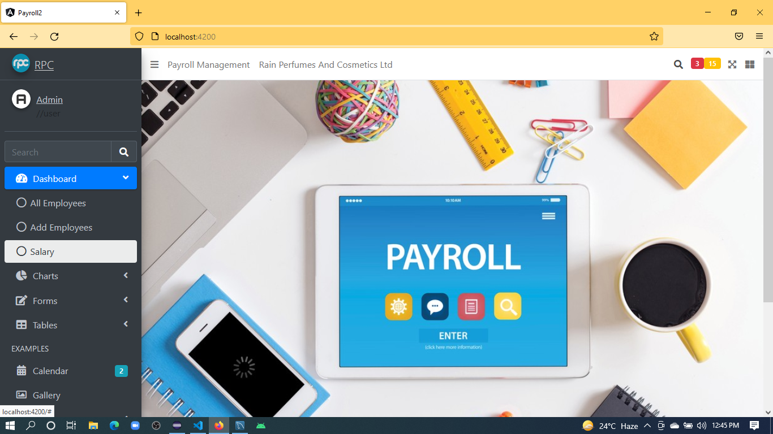
Dashboard

Slide 4
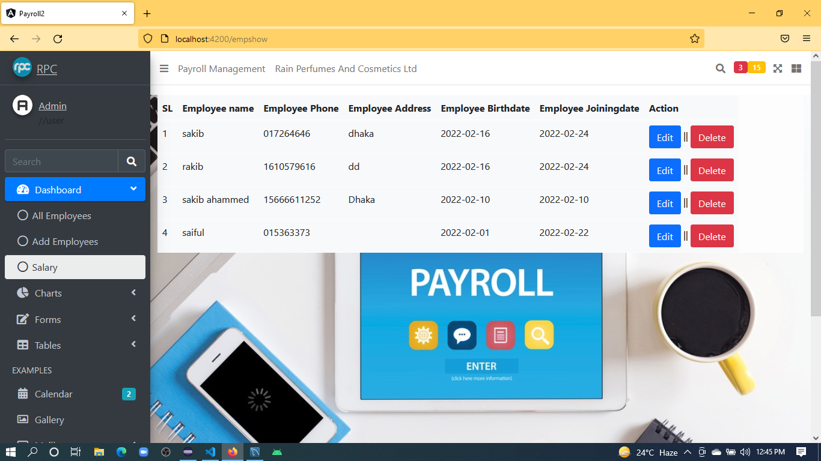
Employee Information

Slide 5
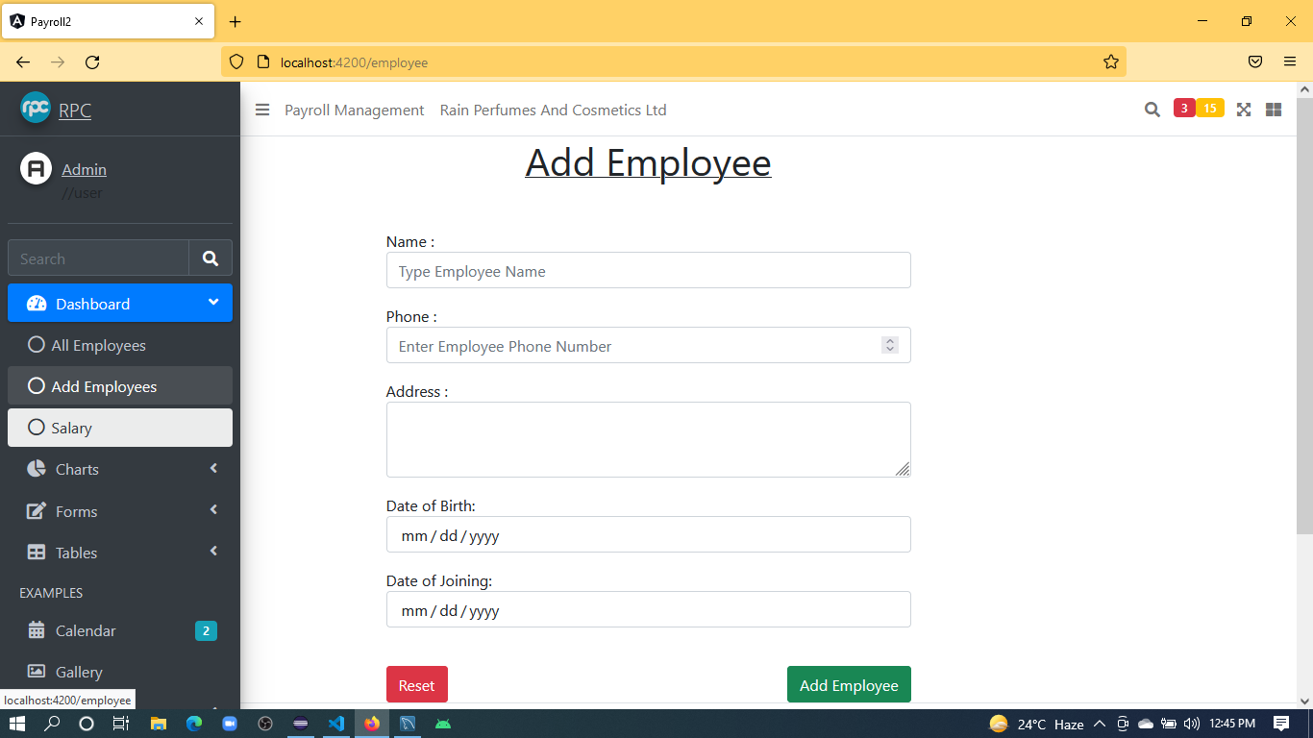
Add Info

Slide 6
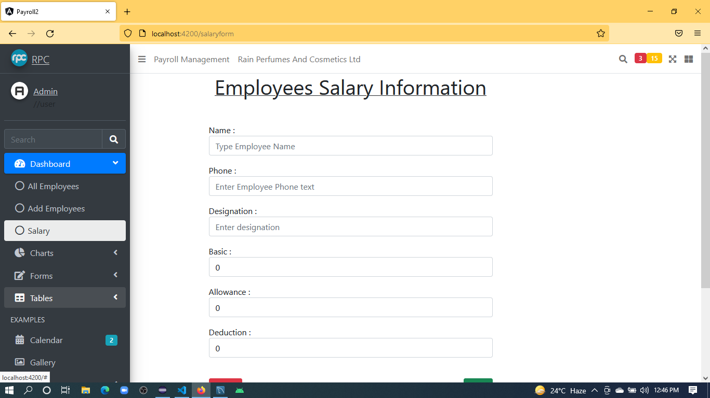
Salary Info

Slide 7
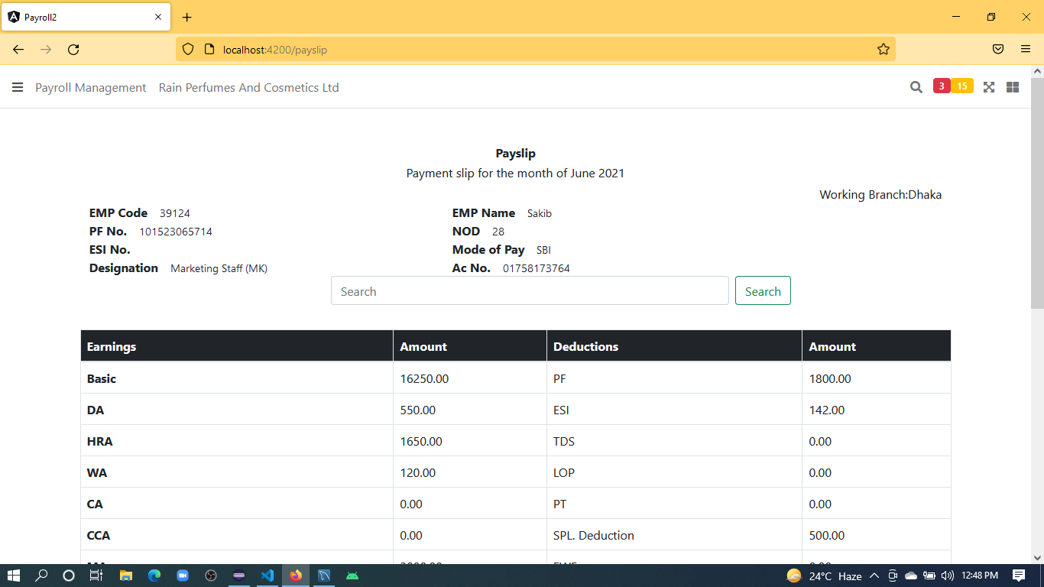
Payslip

Slide 8
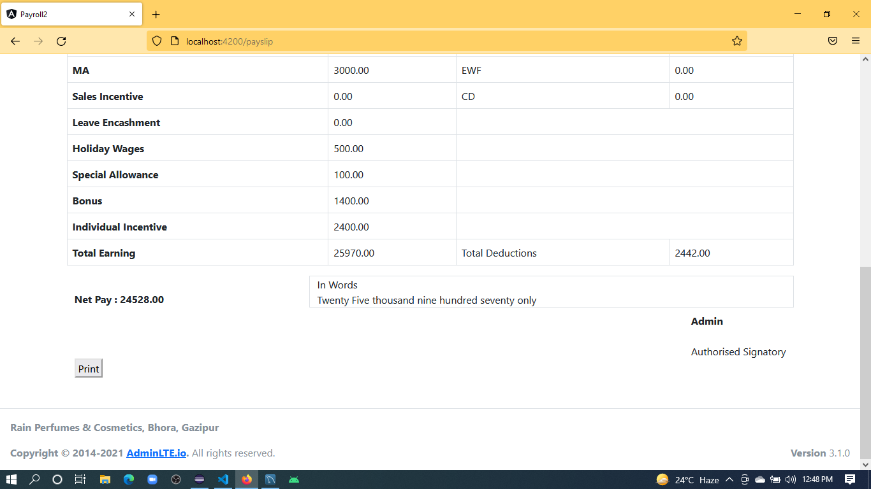
Payslip

Slide 9
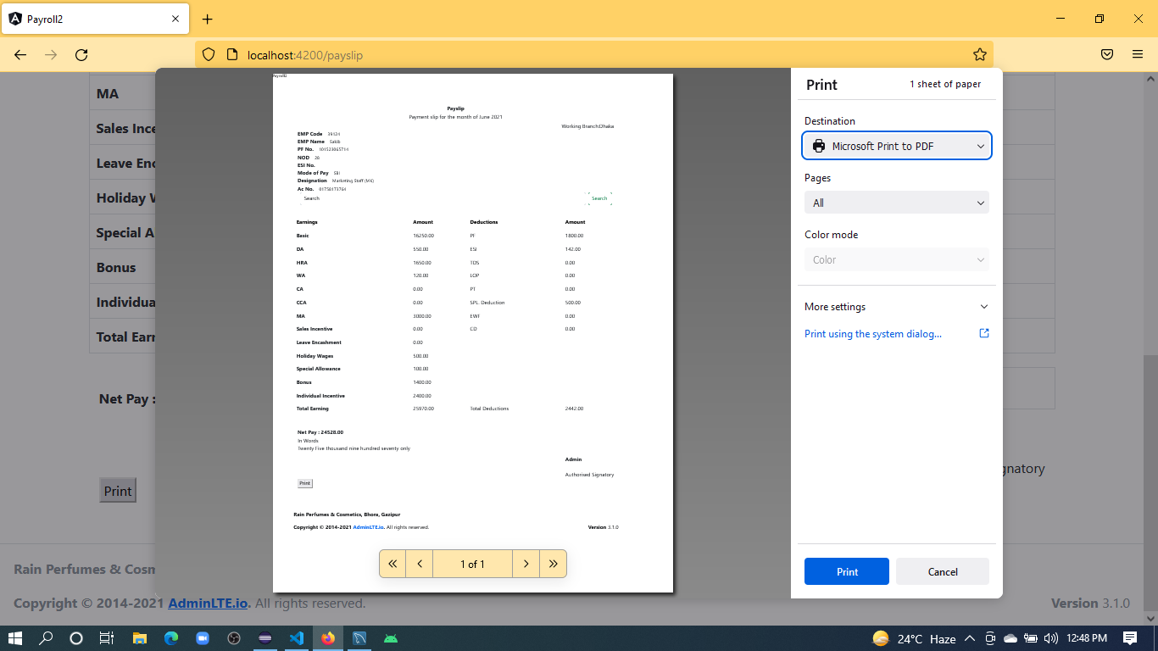
Payslip.pdf

Slide 10
Using tools
VS Code-Angular 6
Eclipse-spring boot
Mysql

